Slide 1

Vrinda
Store
Data
Analysis
Using
MS Excel
By Shravan Jadhav
jshravan354@gmail.com

Slide 2

Objective :
Vrinda store wants to create an annual sales report for 2022. So that, Vrinda can understand their customers and grow more sales in 2023.

Slide 3

Requirements of Vrinda Store:
Compare the sales and orders using single chart
Which month got the highest sales and orders?
Who purchased more- men or women in 2022?
What are different order status in 2022?
List top 10 states contributing to the sales?
Relation between age and gender based on number of orders
Which channel is contributing to maximum sales?
Highest selling category?, etc.

Slide 4

Steps:
Data Cleaning
Data Processing
Data Analysis
Data Visualization
Reports
Insights

Slide 5
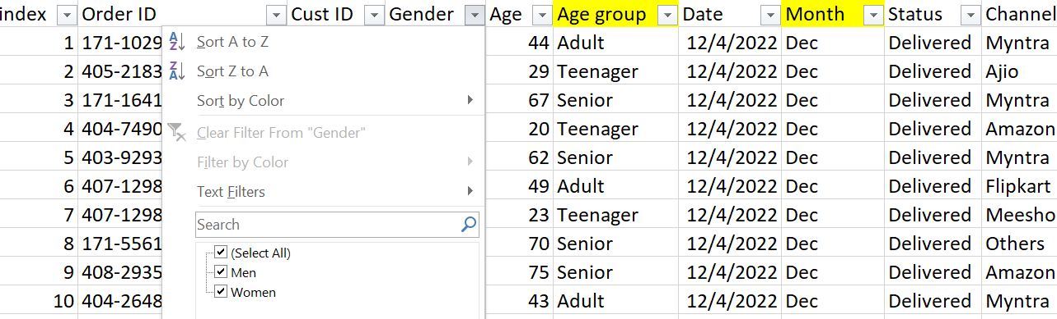
1. Data cleaning
We have cleaned the dataset by removing null values using filter option.
Also we have checked duplicate values.
We prepared data in a specific manner.

Slide 6
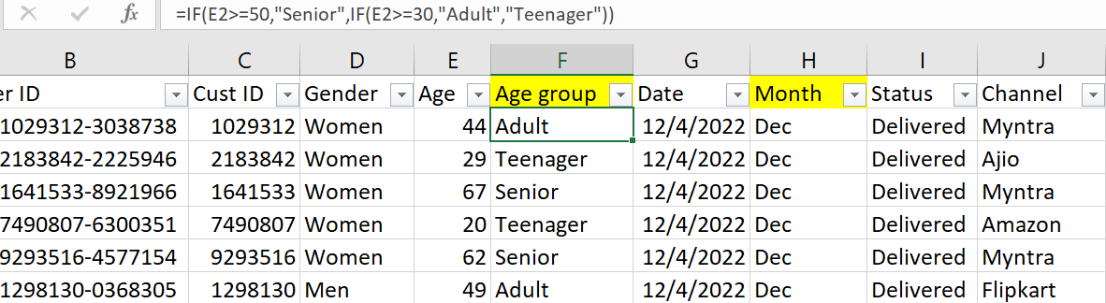
2. Data Processing
We have created some necessary columns as like “Age” and “Month” by using formulae.

Slide 7
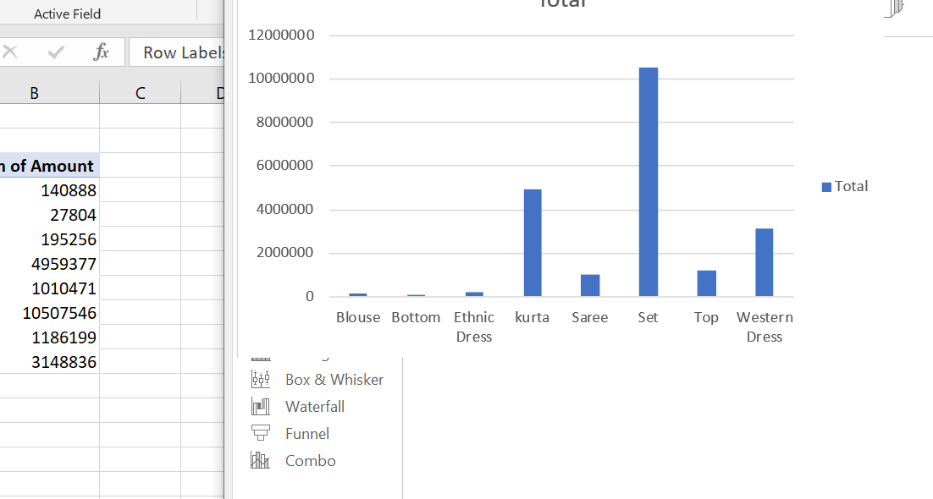
3. Data Analysis

Slide 8
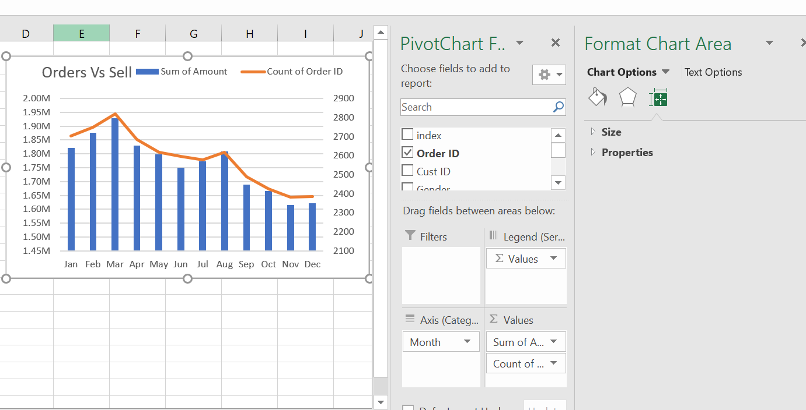
4. Data Visualization

Slide 9
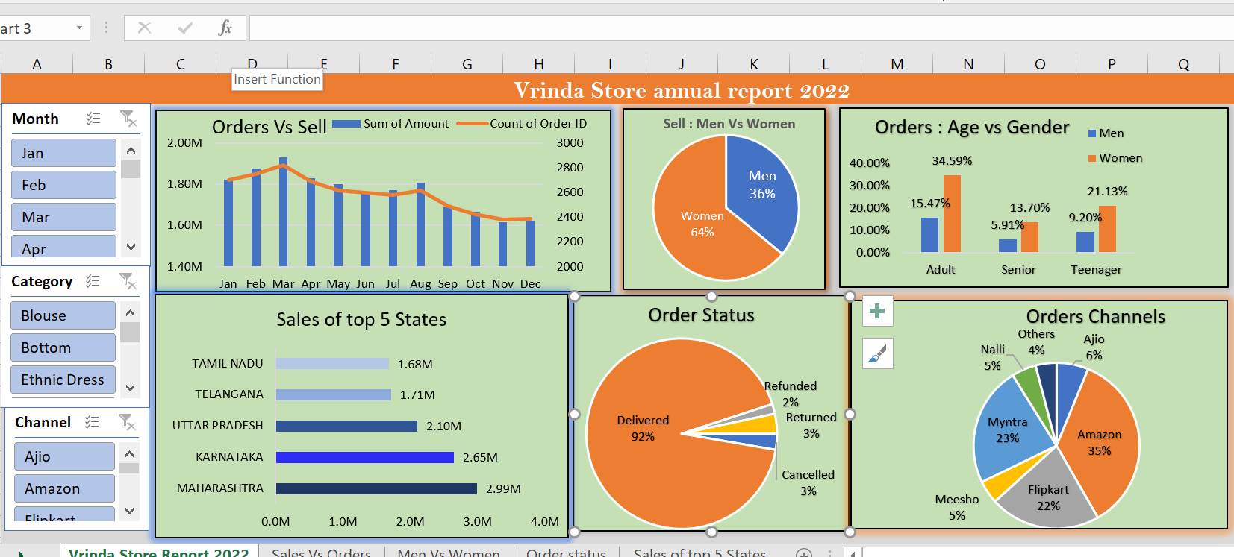
5. Reports

Slide 10

Sample Insights:
Women are more likely to buy compared to men (~65%)
Maharashtra, Karnataka and Uttar Pradesh are the top 3 states (-35%)
Adult age group (30-49 yrs) is max contributing (-50%)
Amazon, Flipkart and Myntra channels are max contributing (~80%)
Final Conclusion to improve Vrinda store sales:
Target women customers of age group (30-49 yrs) living in Maharashtra, Karnataka and Uttar Pradesh by showing ads/offers/coupons available on Amazon, Flipkart and Myntra

Slide 11

Thank You

